Slide 1
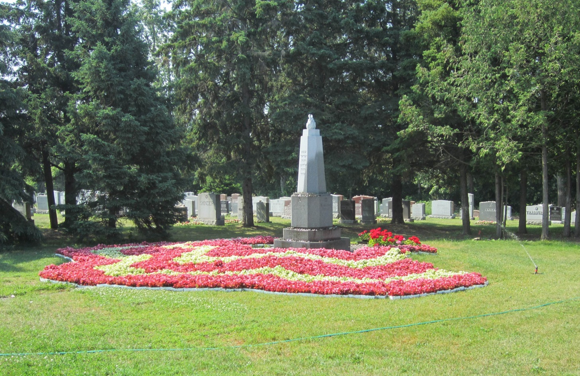

Slide 2
Topics for presentation
History of the Jewish Memorial Gardens
Pre-arrangements for cemetery use
Basic information at time of need
Service providers and their services
Your questions

Slide 3
In March, 1892, members of Agudath Jeshurun Congregation established a burial ground for the Ottawa Jewish Community.
This eliminated the need to send Jewish bodies to Montreal for burial.
John Dover purchased one acre of land on what was then called Metcalfe Road. Today, 120 years ago later, the road is named Highway 31 (Bank Street).
The area was known as the Ottawa Jewish Cemetery.

Slide 4
Dates of entry of additional synagogues and land purchase and expansion
1907 – Congregation Agudath Achim
1913 – Congregation Machzikei Hadas
1928 – B’nai Jacob Congregation
1940 – Agudath Achim acquires more land
1941 – Agudath Israel joins the group and purchases property
1943-1950 - Three more transactions by the existing synagogues brings the total to todays fourteen acres.

Slide 5
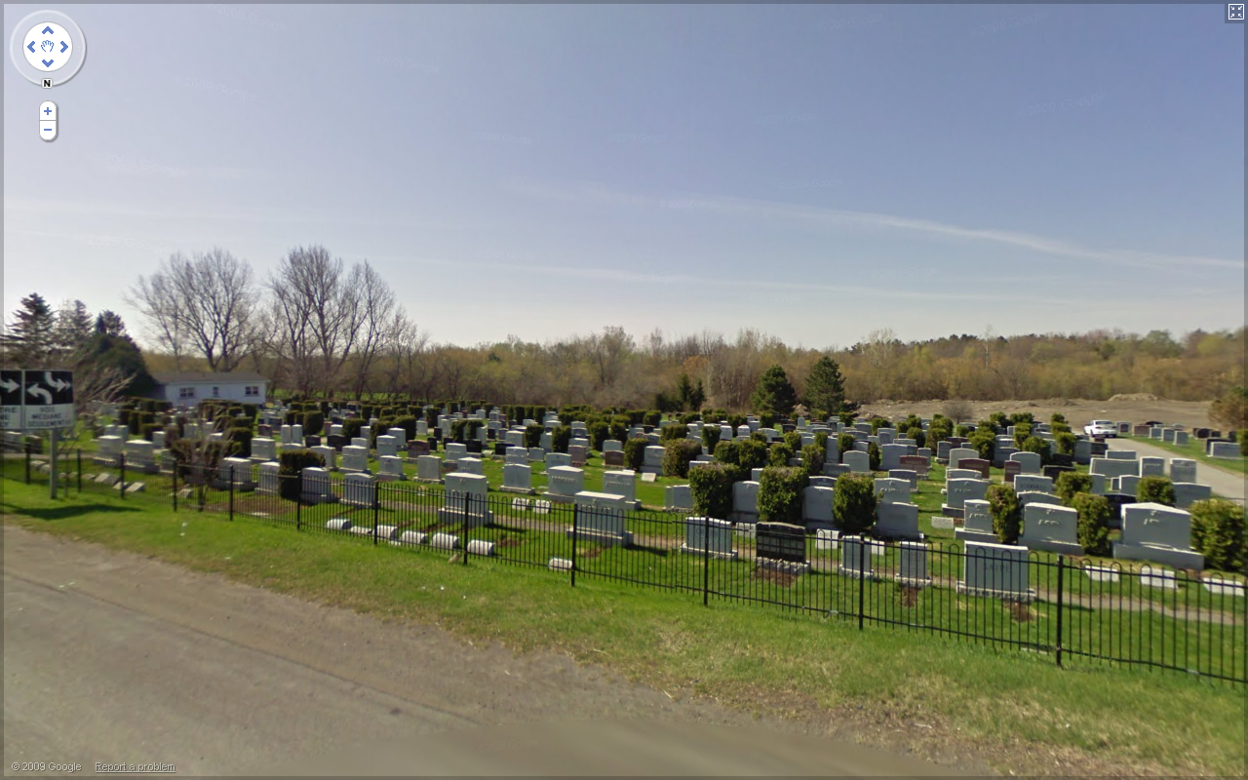

Slide 6
Over the years, synagogues merged.
Today Bank Street serves the members of the following congregations:
Beth Shalom
Machzikei Hadas
Agudath Israel
Beit Tikvah

Slide 7
In 1976, property was purchased on Herberts Corners Road in Osgoode, to allow for the future needs of the Ottawa Jewish Community.
This new cemetery was named Jewish Memorial Gardens
Since 1976, the Osgoode location has been available to all of the congregations. To date, it is used by Agudath Israel, Temple Israel and Young Israel.

Slide 8
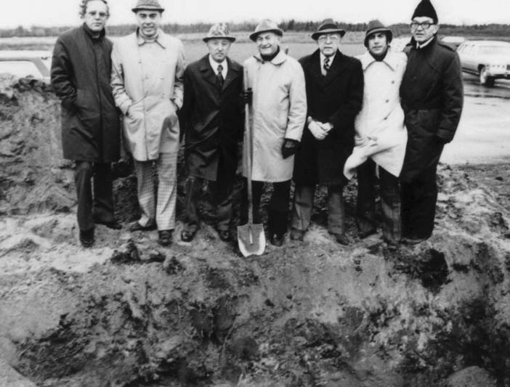

Slide 9
From 1892 until 2008, the individual synagogues controlled the sale
of interment rights to their members.
A cemetery committee existed to administer the maintenance of the two cemeteries.

Slide 10
On July 1, 2008, the six synagogues with the two cemetery locations, transferred the ownership of the two cemetery properties to the Jewish Memorial Gardens.
JMG now handles all aspects of the maintenance, finance, and day to day operation.
The synagogues retain halakhic control over what were previously their sections.

Slide 11
Under the terms of the Founding Members Agreement,
Jewish Memorial Gardens is run by a Board of Directors comprised of members of the six founding synagogues Beth Shalom Machzikei Hadas Agudath Israel Temple Israel Young Israel Beit Tikvah
as well as representation from the Jewish Federation of Ottawa.

Slide 12
Current members of the JMG Board of Directors
Agudath Israel Steve Levinson
Beit Tikvah Barry Cantor
Beth Shalom Peter Greenberg Harvey Slack
Machzikei Hadas Hymie Reichstein, Vice-Chair
Temple Israel Gerald Halpern, Secretary
Young Israel Issie Scarowsky
Jewish Federation of Ottawa Leon Bronstein, Vice-Chair John Diener, Treasurer Jonathan Freedman, Chair
Non-voting Members
Past-Chair – Lawrence Zinman
Executive Secretary – Shelly Fine

Slide 13
New Law and Bylaws
July 2012 Province puts into place a new Cemetery Act.
Purpose of law is to unify the practices of all elements of service providers to grieving families, meaning funeral homes, cemeteries and all affiliated providers.
The Tahara and religious service provided by the Chevra Kadisha is exempted as a religious service.

Slide 14
JMG used this opportunity to refresh, clarify and unify its practices in new bylaws. (available at JMG website)
Lots and plots (multiple lots) may be sold by the owner on the open market, subject to:
The lot has not been used.
No lot within a plot has been used.
The price may not exceed the amount on the current JMG price list.
The purchaser must meet the eligibility criteria for that section.

Slide 15
The right to use of a lot is subject to
the Rights Holder remaining a member of the synagogue in whose section the lot is located and
concordance with the halakhic practices of the synagogue.
Families are responsible for the ongoing maintenance of their memorial markers.

Slide 16
What to do at time of need - 1
Call the JMG Executive Director (ED).
Shelly Fine is the ED. Call her at the JMG telephone number 613-688-3530. To reach the ED, choose the ‘in case of a death’ option.
Make this call as soon as possible at time of need. The exceptions are during Shabbat or a Yom Tov (in which case wait until the ‘restricted’ time is over).

Slide 17
What to do at time of need - 2
The ED will ask for the following information:
name of deceased and Hebrew name
where the deceased is currently located
whether the deceased has interment rights and in which synagogue section
have pre-arrangements been done at funeral home
arrangements for Tahara/Shomer, if necessary
if deceased is male, arrange for Tallit to travel with deceased, if possible
contact information for next of kin or other responsible person

Slide 18
What to do at time of need - 3
The ED will provide information regarding:
the fees which will be collected by the funeral director for:
cemetery opening/closing
tahara (Ottawa Chevra Kadisha)
Shomer
and interment rights/synagogue fees, if applicable
timing for the funeral service
funeral service location

Slide 19
What to do at time of need - 4
Once the basic decisions (such as burial location, choice of funeral home, choice of funeral package, payment of all costs and notification of Rabbi) have been decided, the funeral will take place.
The Executive Director of Jewish Memorial Gardens will assist you with all of the details and will answer your questions as you deal with the many requirements necessary at the time of need. Pre-arrangement, of course, will lessen the number of decisions to be made at that time.
Full details are available on the JMG website.

Slide 20
Flower Planting
Flower Planting
25 Year Planting Plan

Slide 21
For more information, visit www.jewishmemorialgardens.org
Among the information posted there are:
By-laws: Governance; Structure; Operations
Price list
Purchase Contract; Resale Endorsement
More will be added as Jewish Memorial gardens continues to develop information useful to our community.

Slide 22
JMG PRICE LIST
Purchase of an Interment Right
Bank Street - $3750
Osgoode - $2400
Opening and Closing of Grave
Summer months - $2100
Winter months - $2600
Prices are current as of October 2012, and are subject to change.

Slide 23
Other costs, non-JMG, associated with a funeral
-Professional Funeral Director Services
Tahara (Chevra Kadisha)
Shomer
Synagogue Membership Fees
Clergy
Additional sections will be added to our website to provide more information on these charges
www.jewishmemorialgardens.org

Slide 24
QUESTIONS? ? ?

